Slide 1
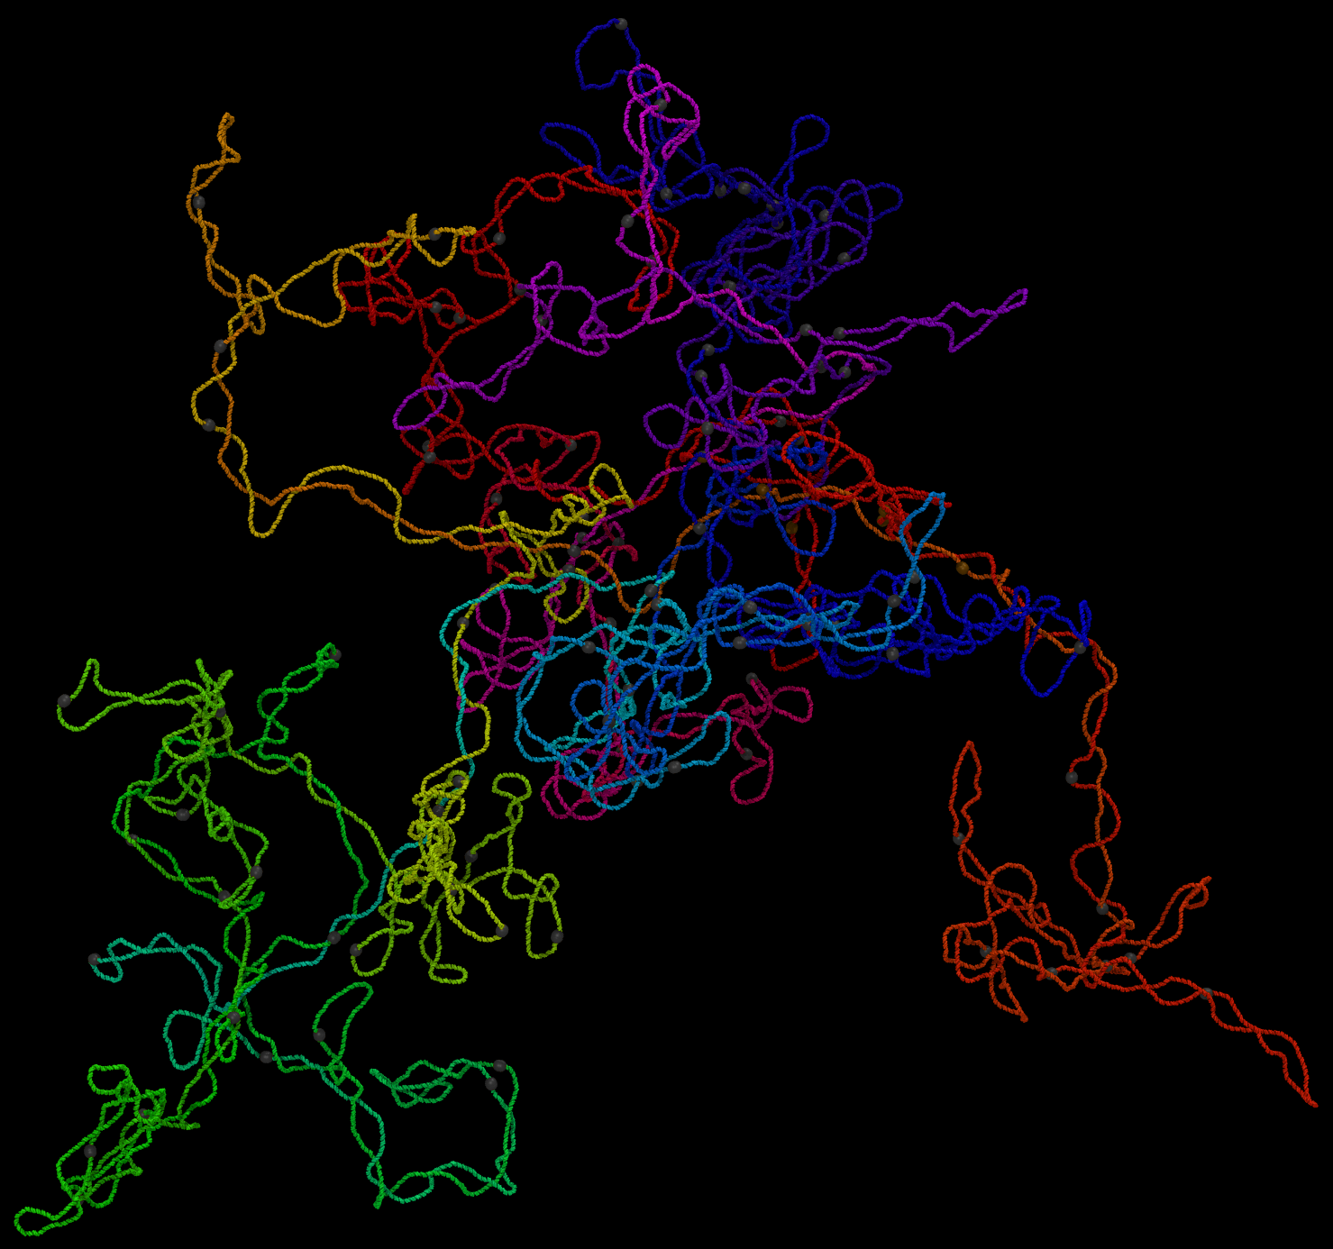

Coarse-Grained Simulations of Supercoiled DNA
Cayson Hamilton

Slide 2
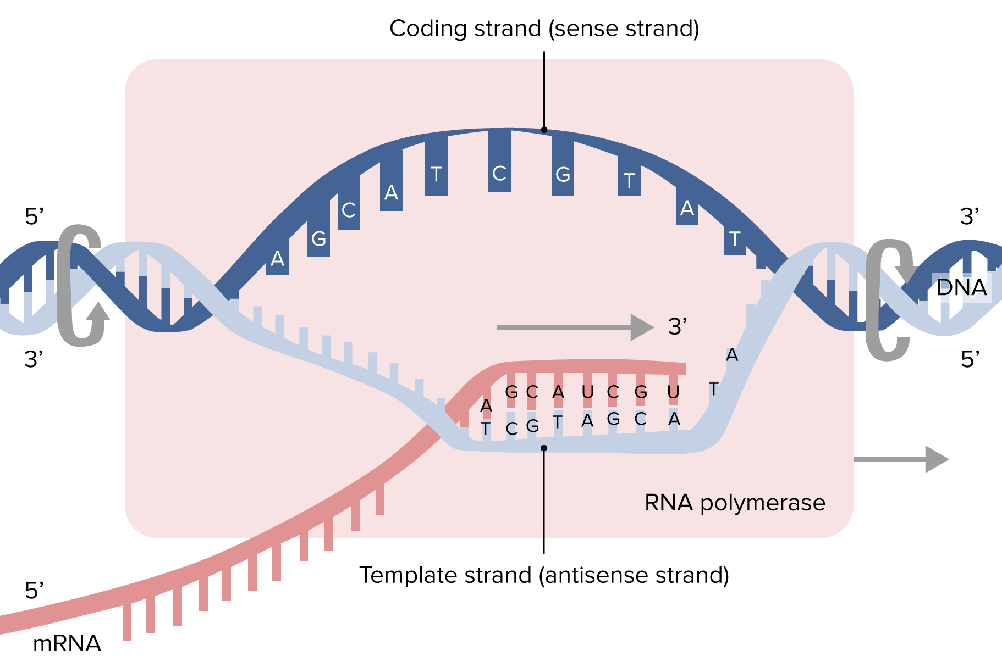
Fundamental Processes of Life
DNA replication every 4 - 20 minutes
DNA transcription creates genes
https://medium.com/@biologynotes/dna-replication-302203b5c3d8
https://www.lecturio.com/concepts/stages-of-transcription/

Slide 3
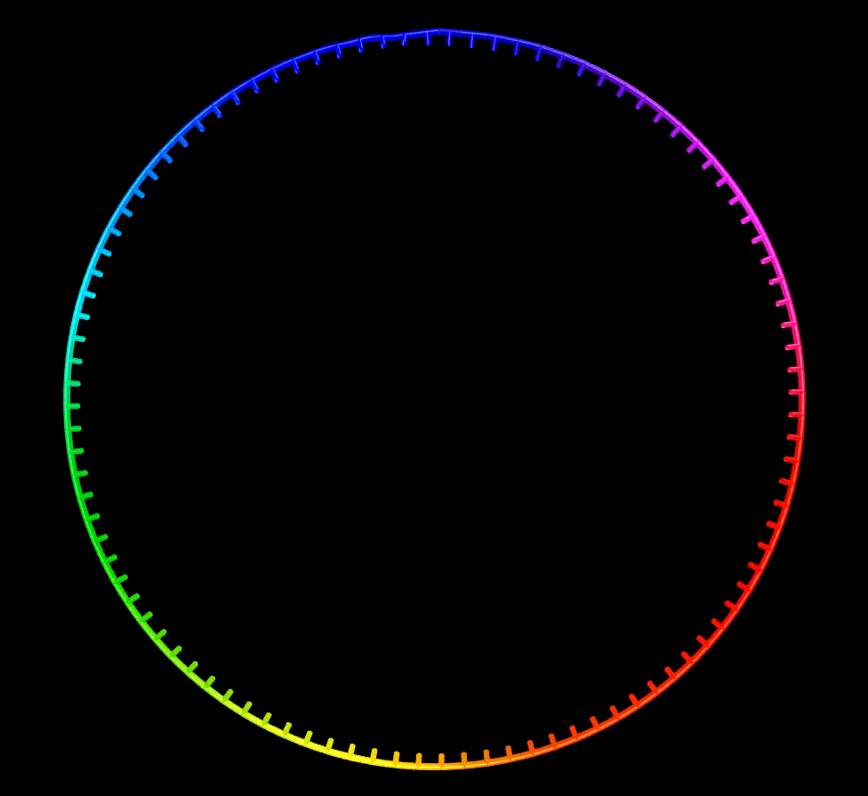
DNA Compaction
Prokaryotic DNA is circular
Compacted 1000-fold to nucleoid shape
How is DNA compacted to accommodate for such mechanically complicated processes?

Slide 4
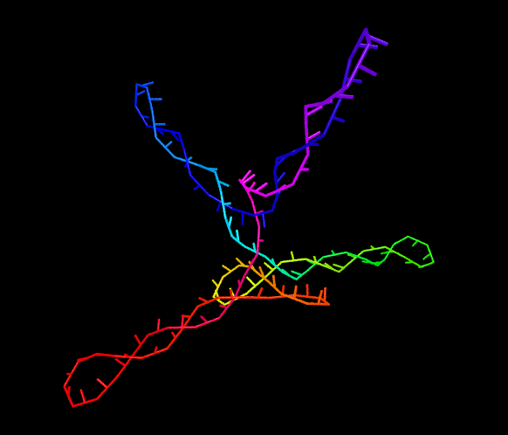
Topological Structure
Plectonemic loops segregate DNA domains
Transcription enzymes read the genes in varying domains
Replicated strands are pulled to opposite poles for division

Slide 5
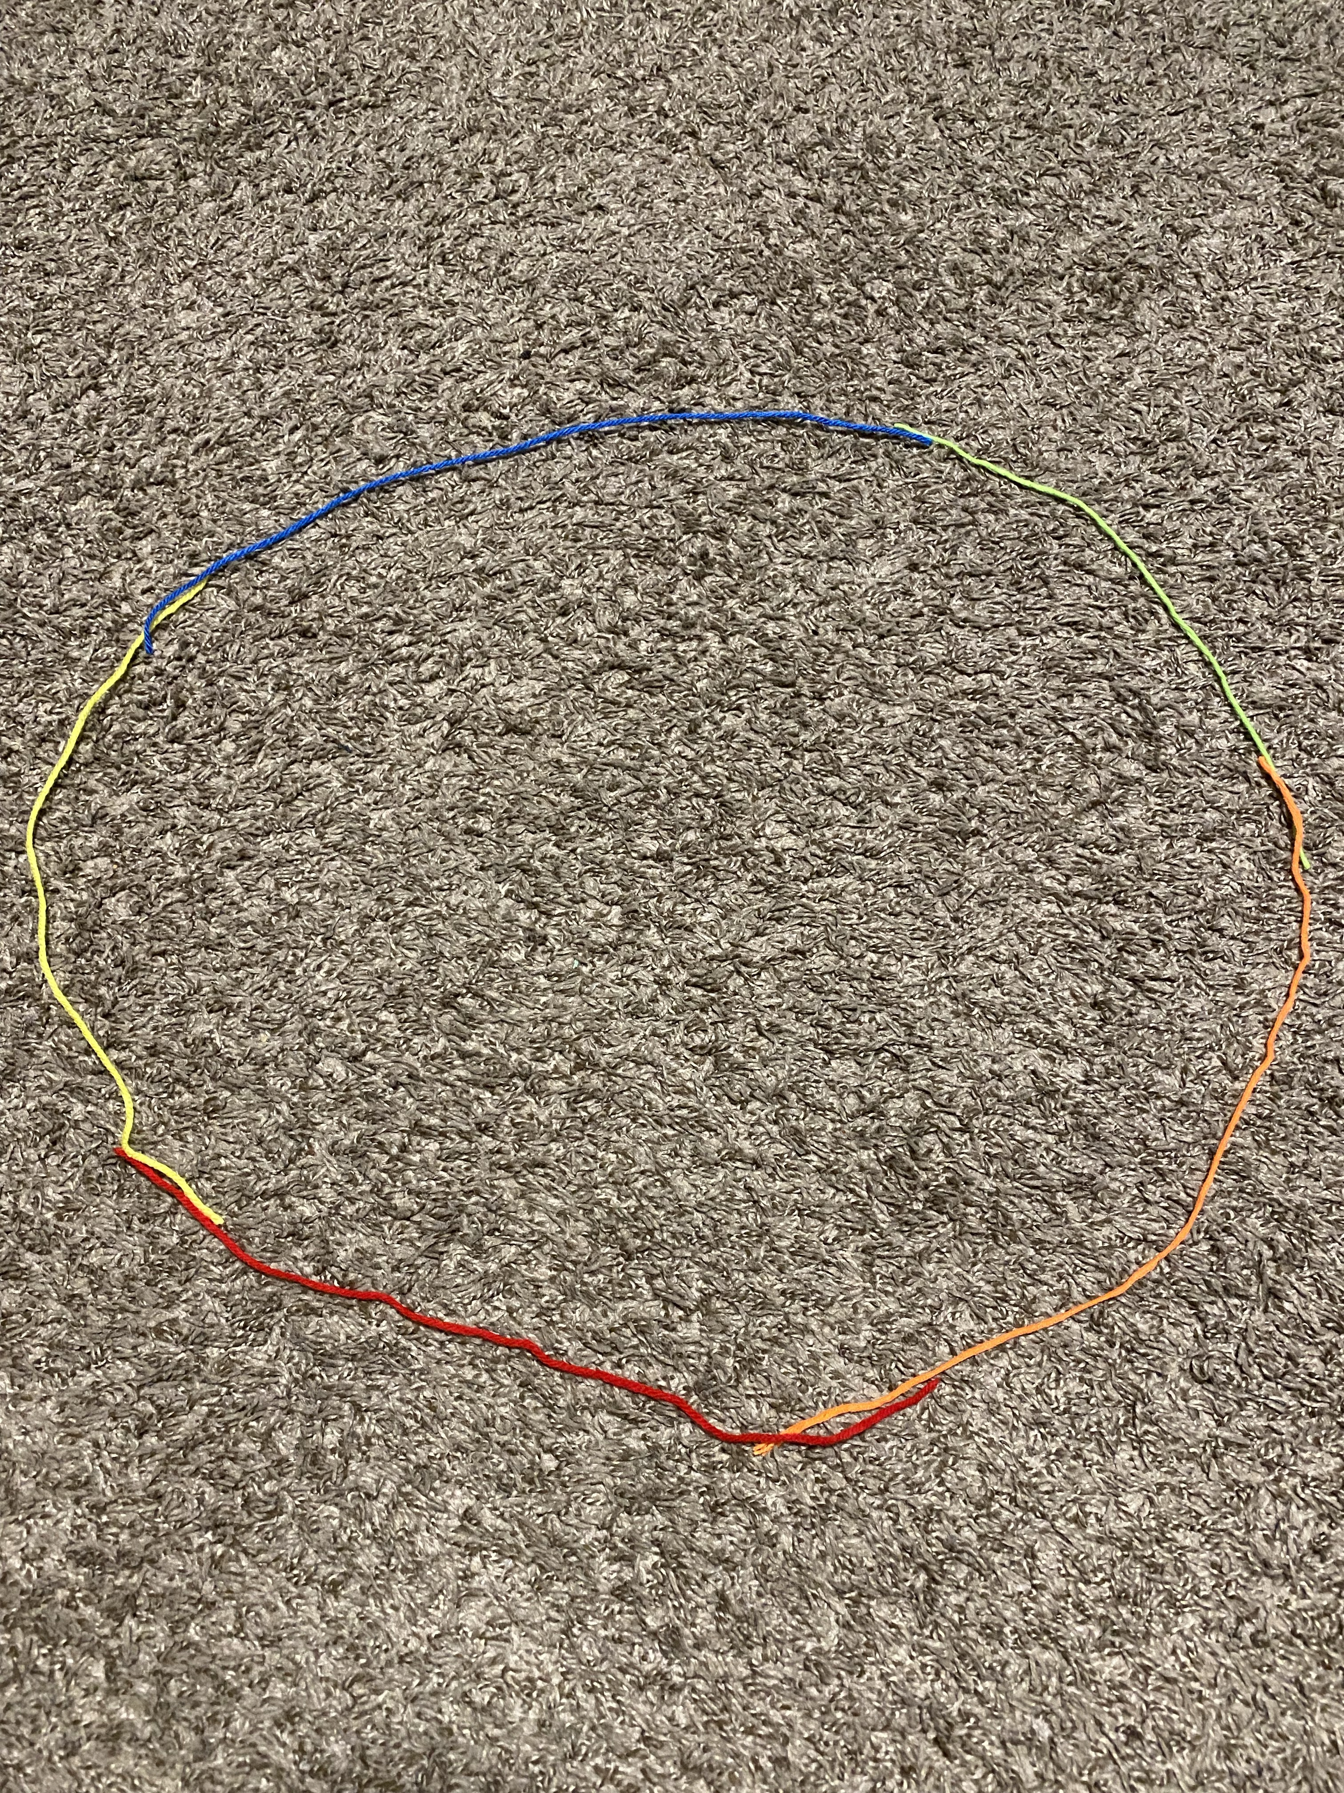
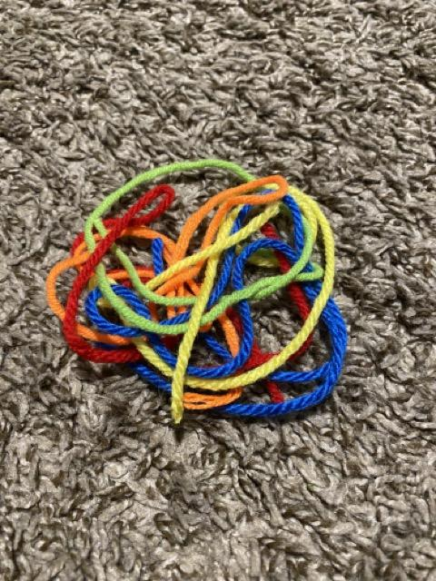
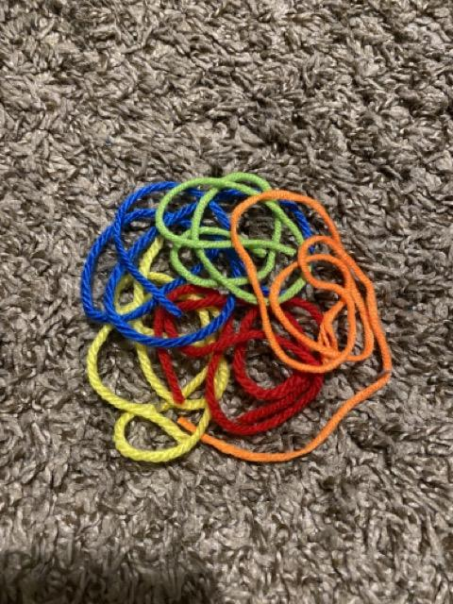
Organization and Gene Expression
Unwound configuration, DNA coding for the same things are located in same vicinity
DNA is very disorganized, tangled and in disarray
Not correct!
DNA is highly organized/segregated by gene
Correct!

Slide 6
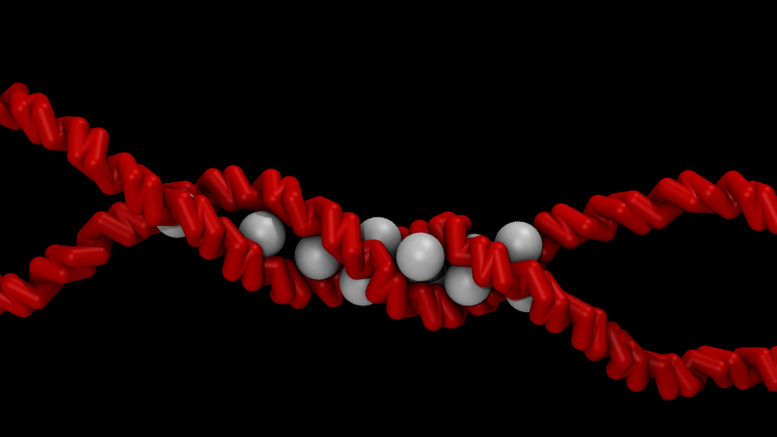
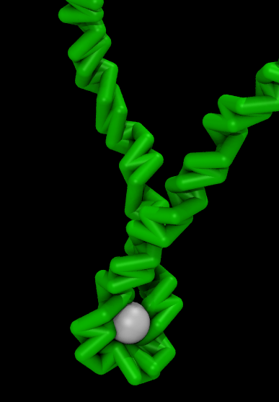
Nucleoid Associated Proteins (NAPs)
NAPs bind to the DNA to form the nucleoid structure
H-NS (histone-like nucleoid-structuring) proteins regulate DNA topology
IHF (integration host factor) proteins condense the chromosome
H-NS proteins
IHF proteins

Slide 7
Visualizing NAPs and Their Topological Effects
3 Simulations:
“Naked DNA” without any binding proteins
H-NS proteins
IHF proteins

Slide 8
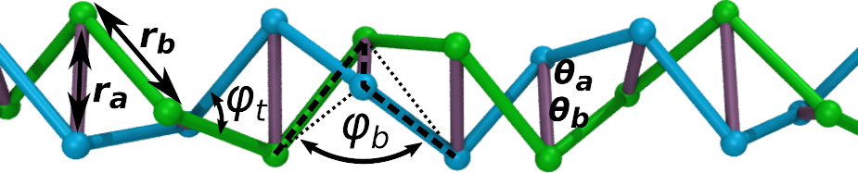
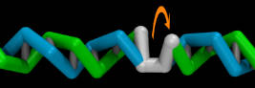
Simulation Specifications
~100,000 base pairs → 10.5 base pairs per helical turn
3 base pairs per monomer, 2 beads per monomer
Run very slowly, for a long period of time → 180 million timesteps (picoseconds)
100 twist motors produce constant torque

Slide 9
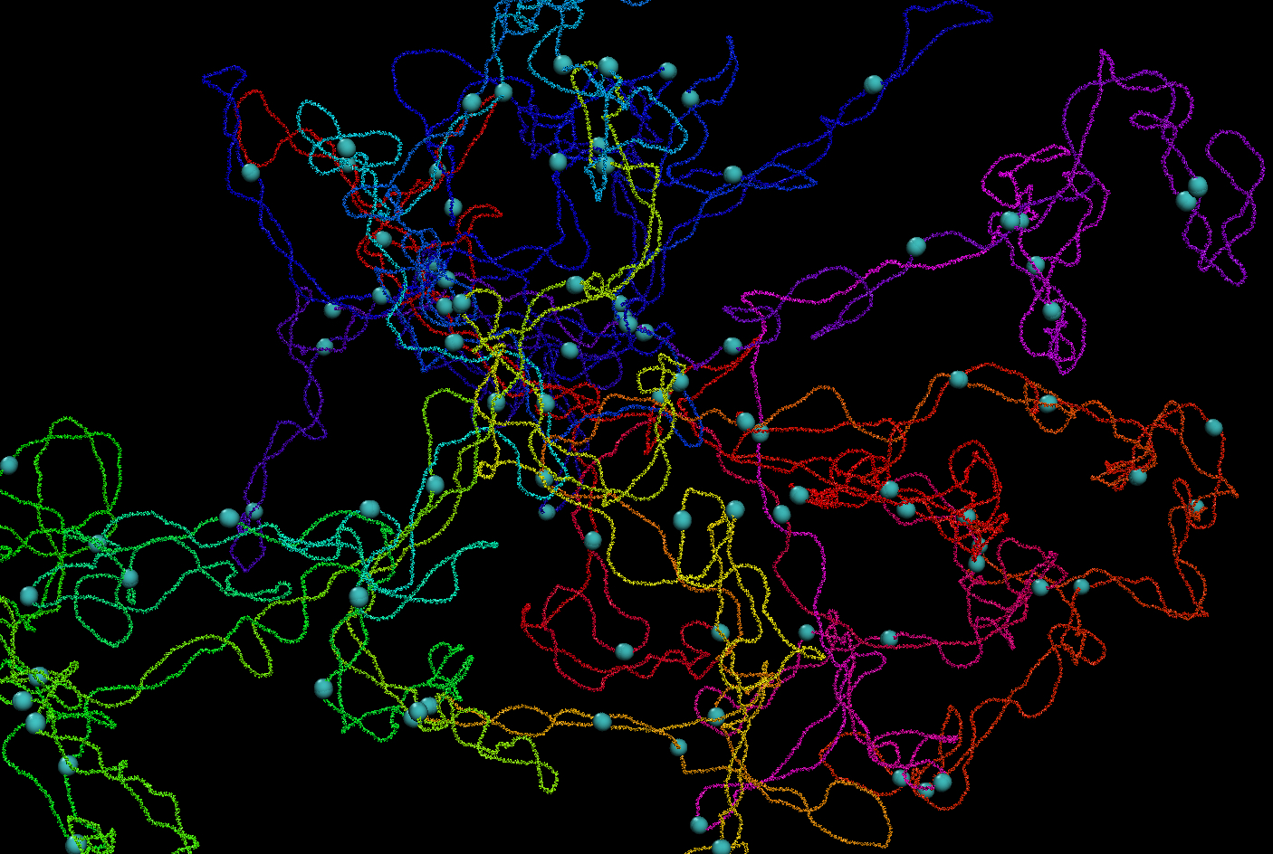
“Naked DNA” — 100 twist motors
Visualizing the twist motors

Slide 10
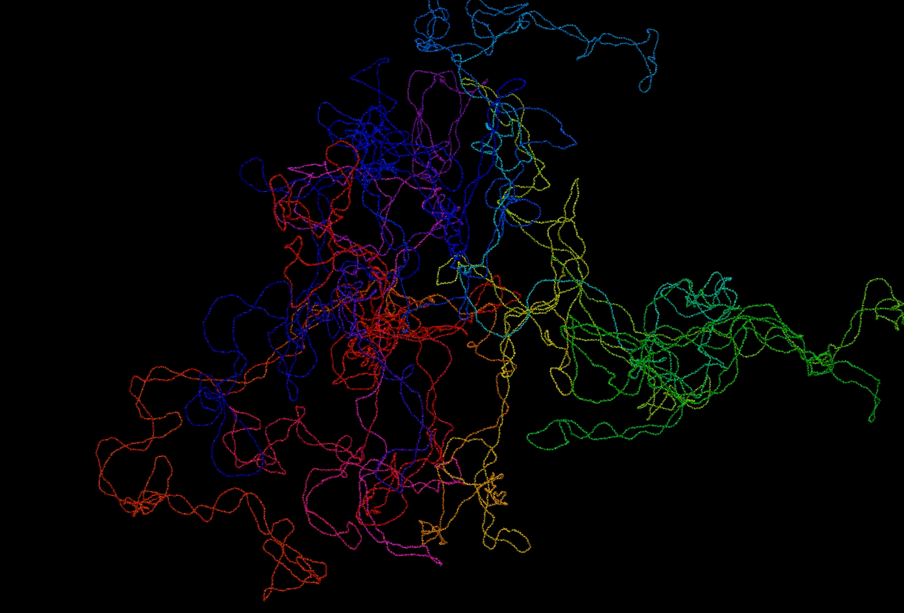
A Look at The Structure

Slide 11
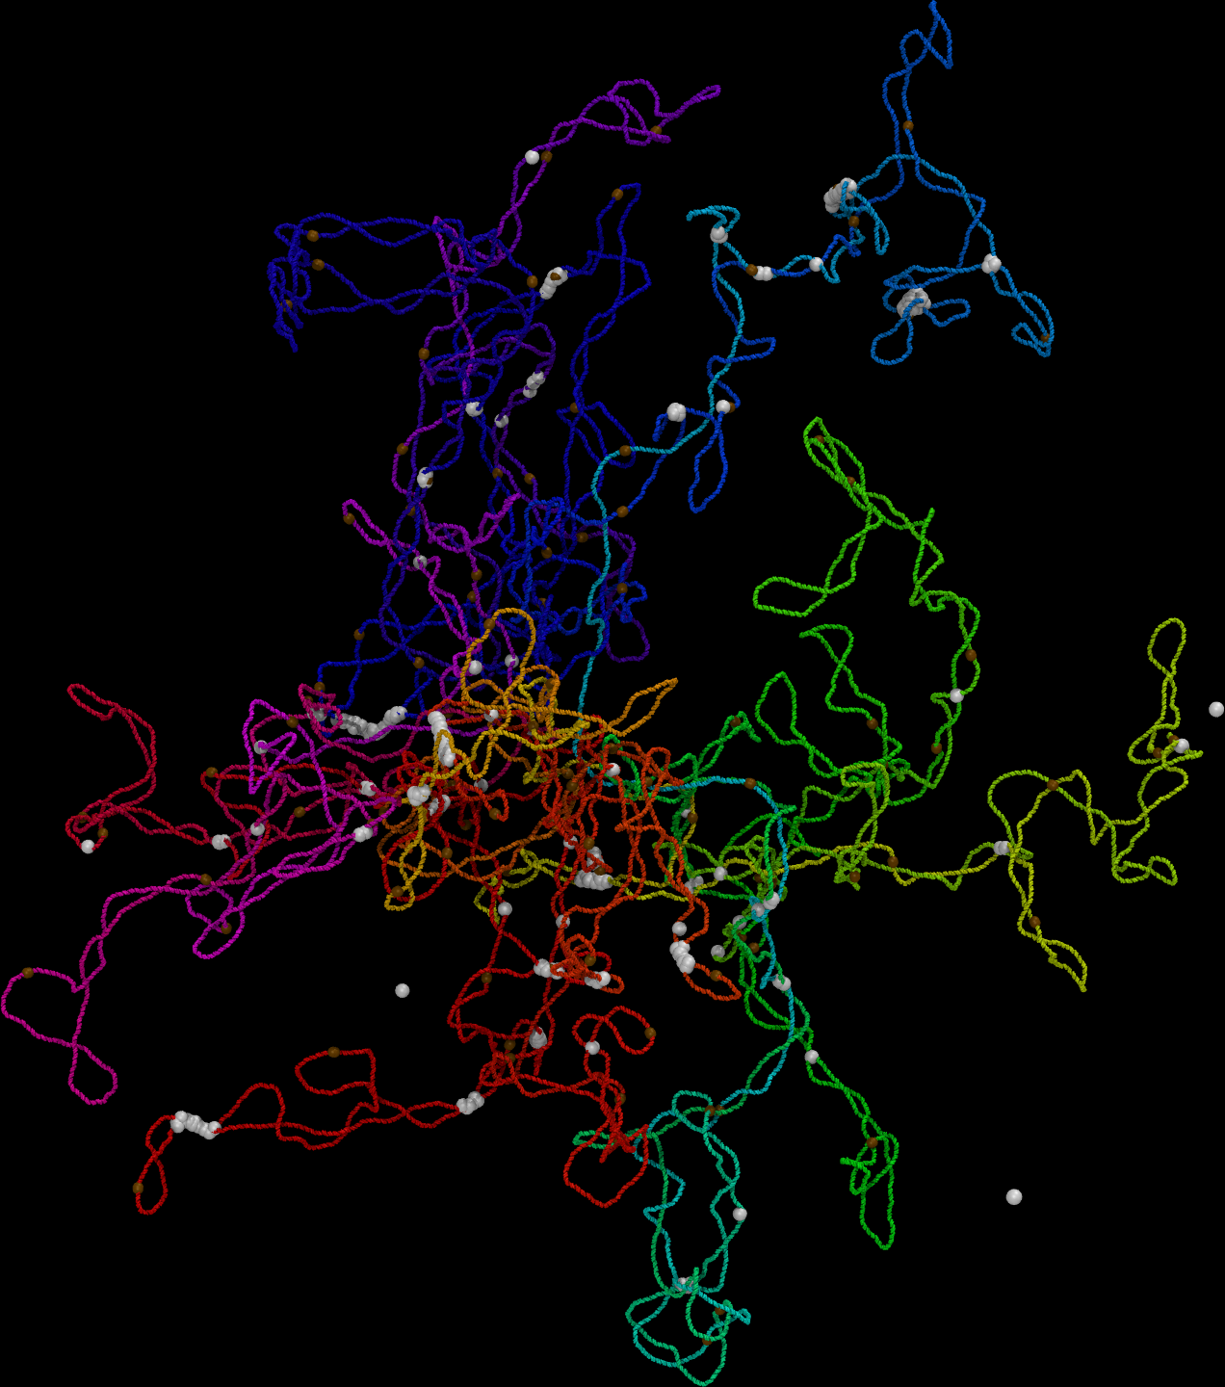
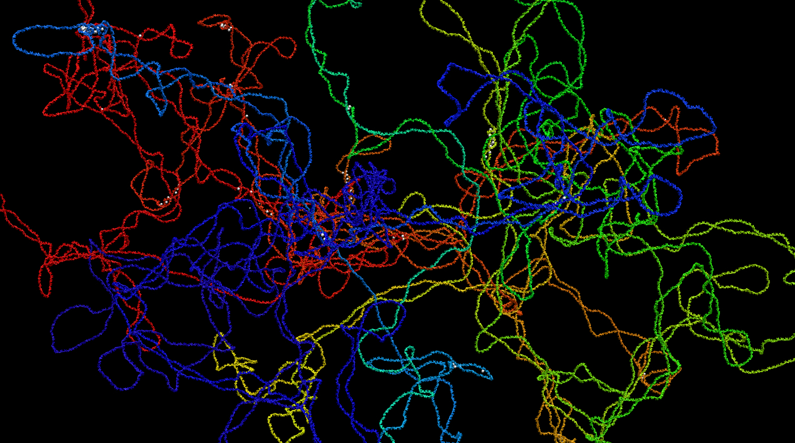
257 H-NS Proteins
*Allows for reversible binding*

Slide 12
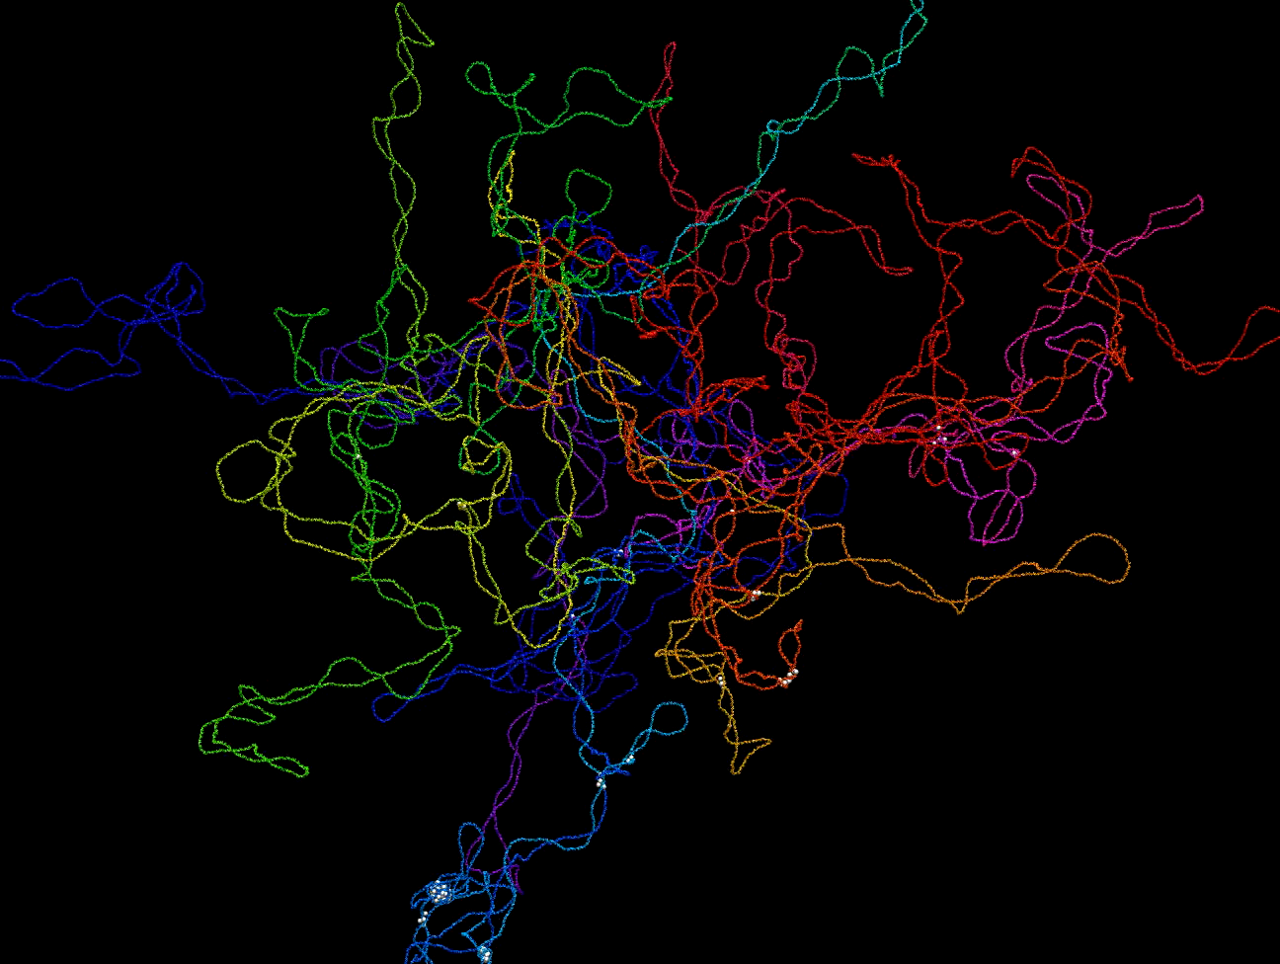
A Look at The Structure

Slide 13
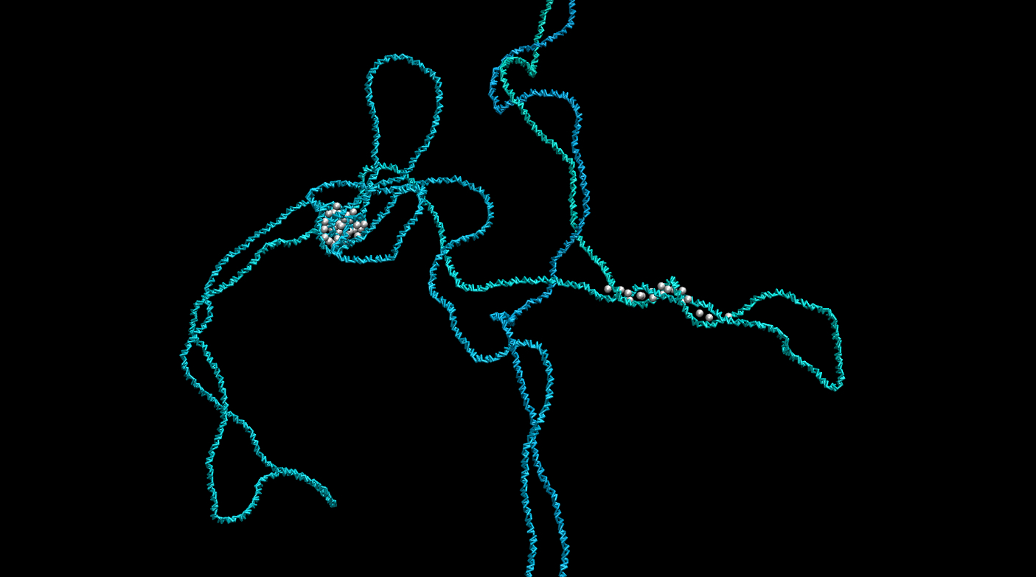
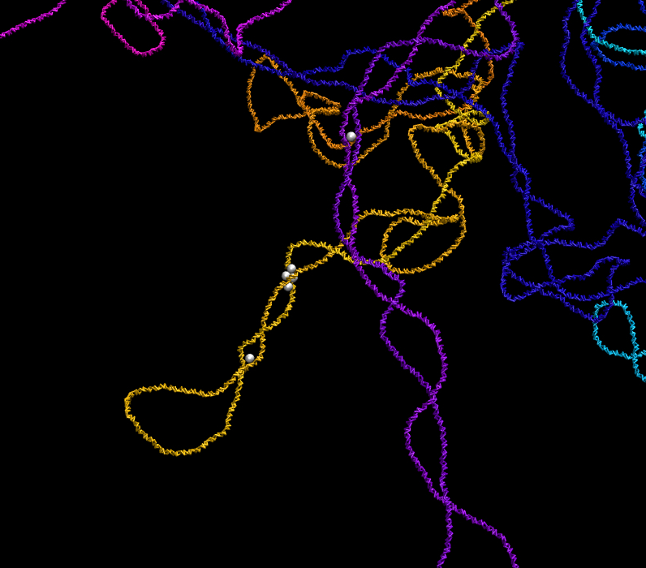
Plectonemic Loops/Topological Domains

Slide 14
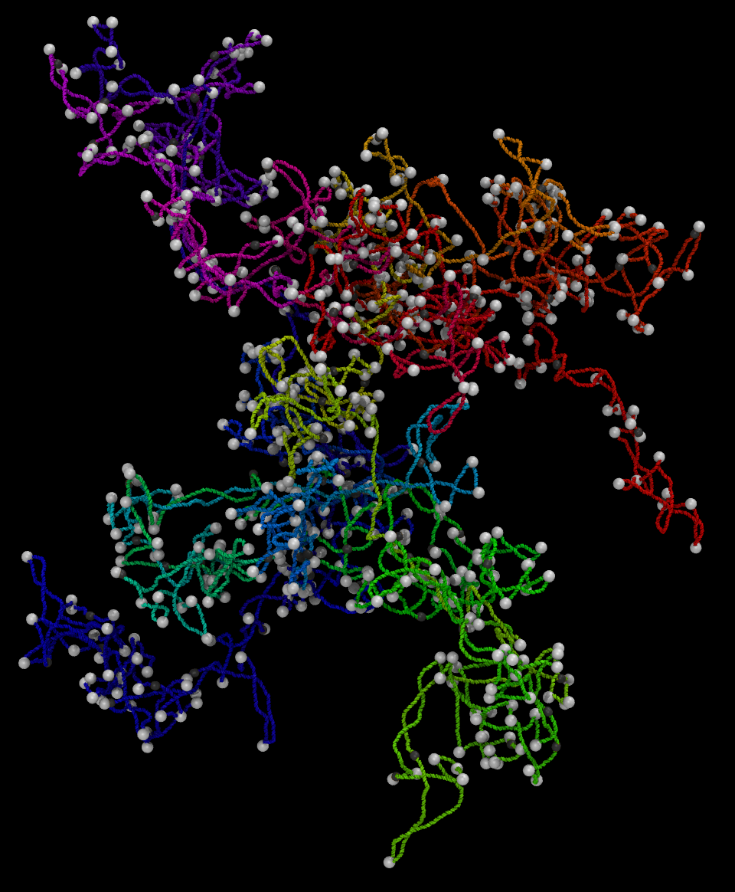
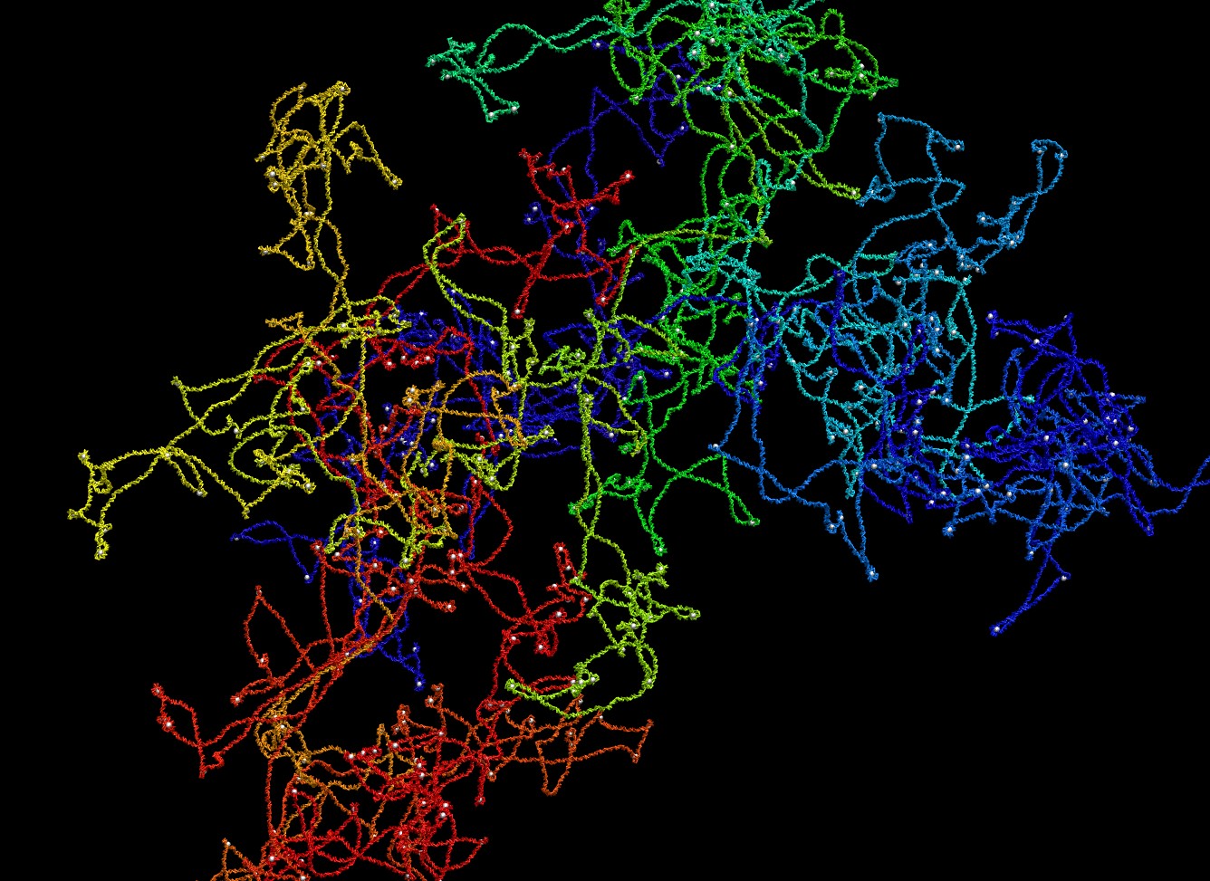
604 IHF Proteins
*No reversible binding*

Slide 15
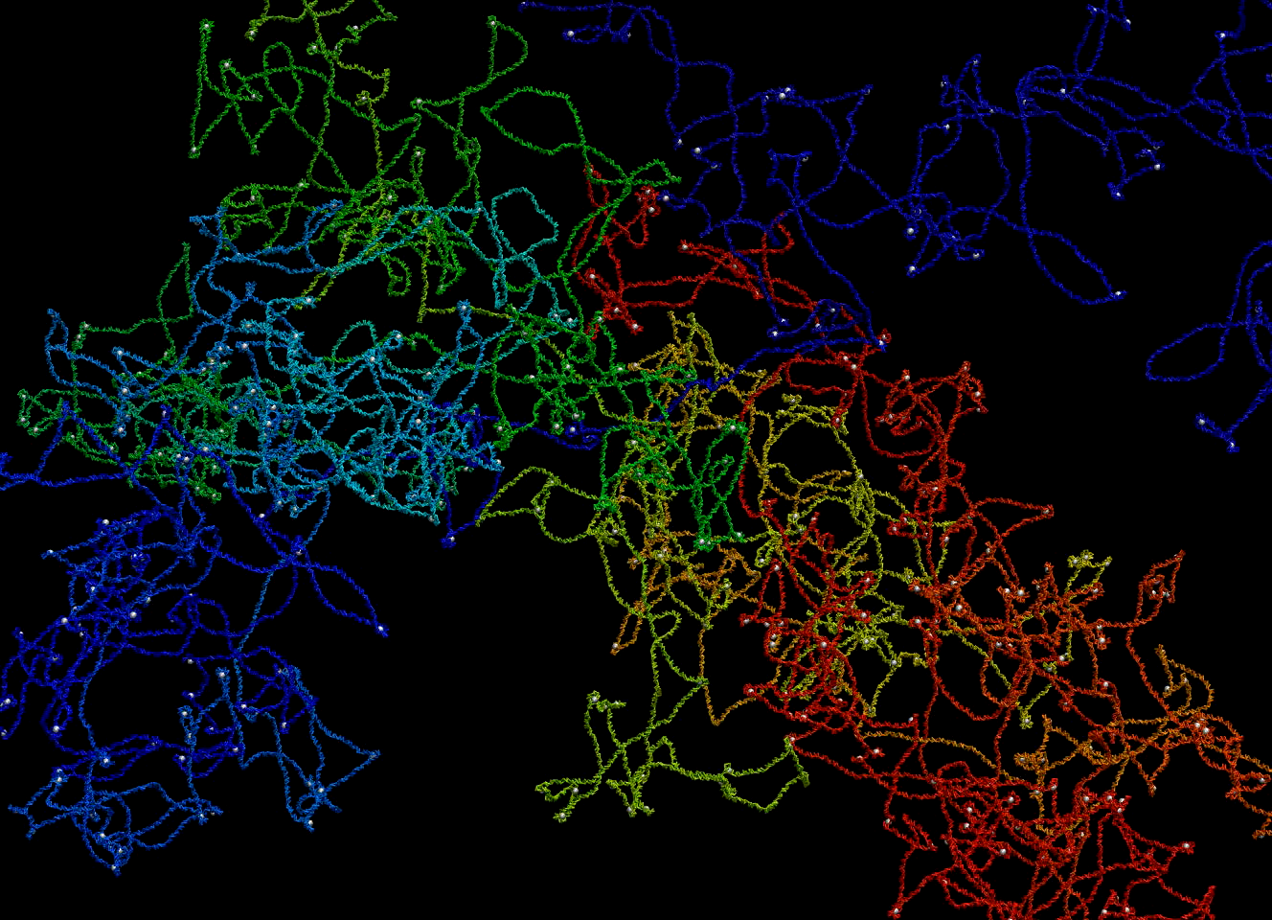
A Look at The Structure

Slide 16

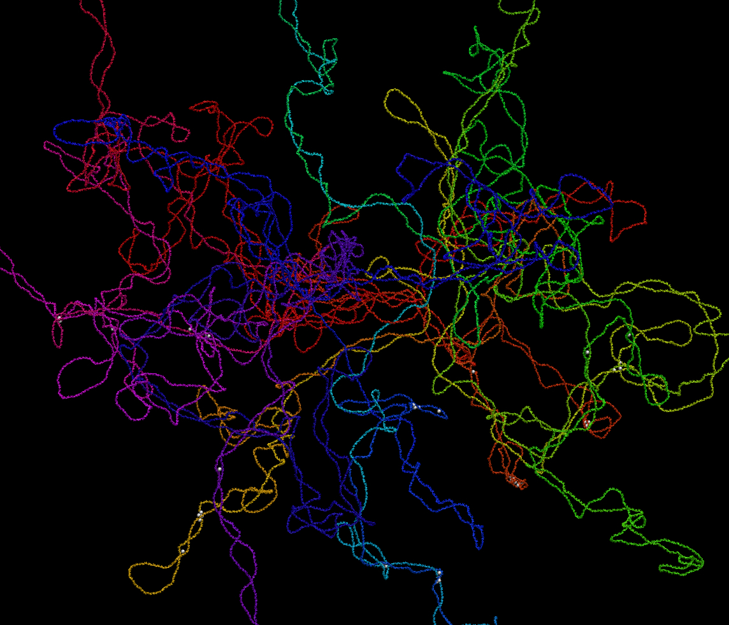
Comparison
Naked DNA
H-NS Proteins
IHF Proteins

Slide 17
Comparison
Naked DNA
H-NS Proteins
IHF Proteins

Slide 18
Going Forward/Applications
Build upon these models as steppingstones towards a fully functional bacterial DNA model
Combine proteins in simulations as well as explore the effect of other known NAPs
Contribute to the knowledge and thus the ability of medicines to treat bacterial infections

Slide 19
Acknowledgements
Dr. Andrew Jewett — Moltemplate
Dr. Gus Hart — Advisor
Dr. Grant Jensen — Co-Advisor
College of Physical and Mathematical Sciences — Funding
BYU Supercomputing — Computing Resources

